Slide 1

Heart Disease Prediction
Presented By
Khush Patel(31)
Reeya Patel(38)
Neel Patel(36)
Haard Patel(26)
Guide By :
Prof. Parth Parekh

Slide 2
Problem Definition
→ Now a Days A major challenge facing in Healthcare organizations(hospitals , medical centers)
Is to provide Quality of services at affordable costs. Quality of Service is mainly depends on correct prediction of doctor .
→ Poor clinical decisions can lead to disastrous consequences which are unacceptable.
→ So to Reduce the cost of clinical tests , organizations need computer based information for prediction of best decision.

Slide 3
EXISTING SYSTEM
In India , clinical decisions are often made based on doctors Experience rather than on the knowledge of rich data hidden in the database.
This practice leads to unwanted errors & high cost which affect to quality of service provided to patients.
There are many ways that medical misdiagnosis is present itself , whether a doctor is at fault , or hospital staff etc.
The national patient safety foundation cited that 42% of medical patients feel that they have had experienced a medical error or misdiagnosis.

Slide 4
Dataset Explanation
Gender :
Male : Male
Female : Female
Age :
<25 : Low
>25 and <50: Medium
>50 : High
Smoker :
Yes : Yes
No : No
BPMed :
Blood Pressure Medicine
Yes : Yes
No : No

Slide 5
Cont…
Stroke :
Yes : Yes
No : No
Hypertension:
Yes : Yes
No : No
Diabetes:
Yes : Yes
No : No

Slide 6
Cont…
Cholestrol:
<200 : Low
>200 and <240: Medium
>240 : High
Systolic :
>120 : High
<120 : Low
Diastolic :
>80 : High
<80 : Low

Slide 7
Feature Extraction
In Data Preprocessing Feature Extraction step is require to get dataset actually you want…
So in out dataset few attributes are not necessary like…
Education
Birth date
So both attributes are removed as not required

Slide 8
CATEGORIZATION
EX. Cholesterol
totCholNormal =[]
for i in totChol:
if(i>240):
x=2;
elif(i>200 and i<240):
x=1;
elif(i<200):
x=0;
else:
x=-1;
totCholNormal.append(x)

Slide 9
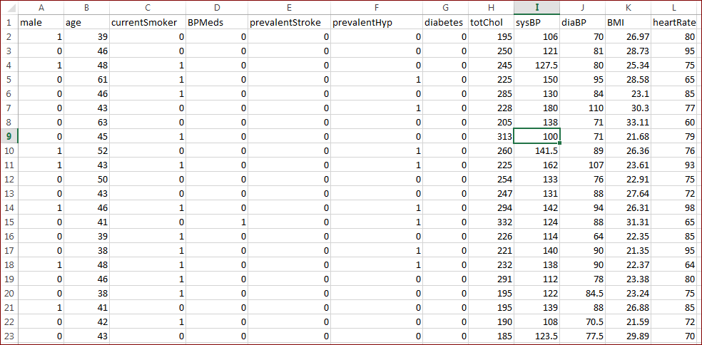
Cont…

Slide 10
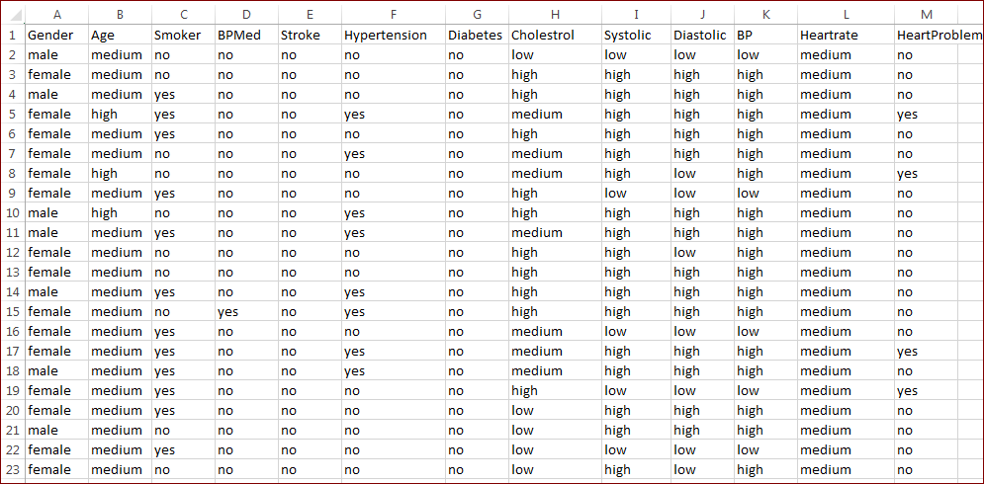
Cont…

Slide 11
Literature Review
Name | Improved Study of Heart Disease Prediction System using Data Mining Classification Techniques
Year | 10 june,2012
Type | Research paper
Proposed | Initially dataset contained some fields, in which some value in the records was missing. These were identified and replaced with most appropriate values using Replace Missing Values filter from Weka 3.6.6.
Conclusion | Naïve Bayes using Weka tool

Slide 12
Cont…
Name | Predicting and Diagnosing of Heart Disease Using Machine Learning Algorithms.
Year | 6 june,2017
Type | Research paper
Proposed | four machine learning algorithms, classifiers are applied on same data and results are compared on the basis of misclassification and correct classification rate and according to experimental results.
Conclusion | Naïve base classifier is the best in performance for prediction of heart disease.

Slide 13
Cont…
Kaggle Dataset Interpretations and Learning
Click here

Slide 14
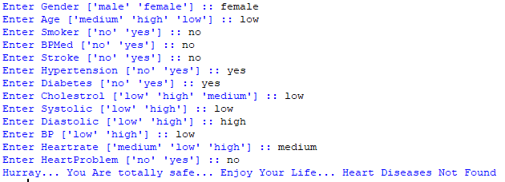
Naive Bayes - Output

Slide 15
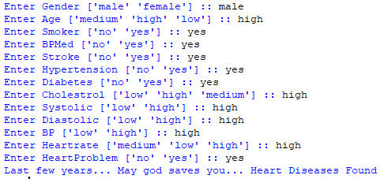
Naive Bayes - Output

Slide 16
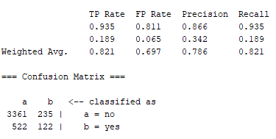
Confusion Matrix

Slide 17
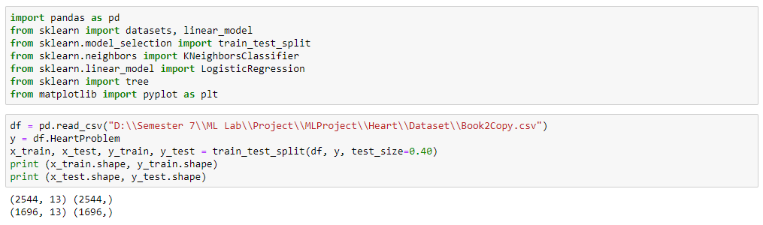
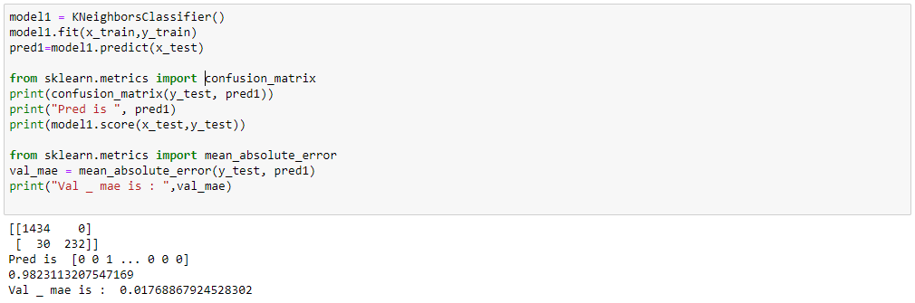
KNN (Using Libraries)

Slide 18
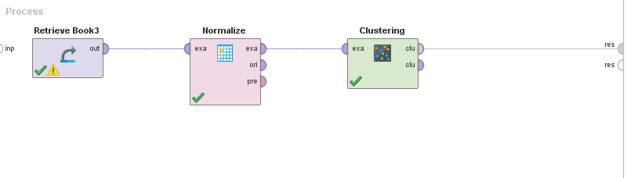
Rapidminer Model Test

Slide 19
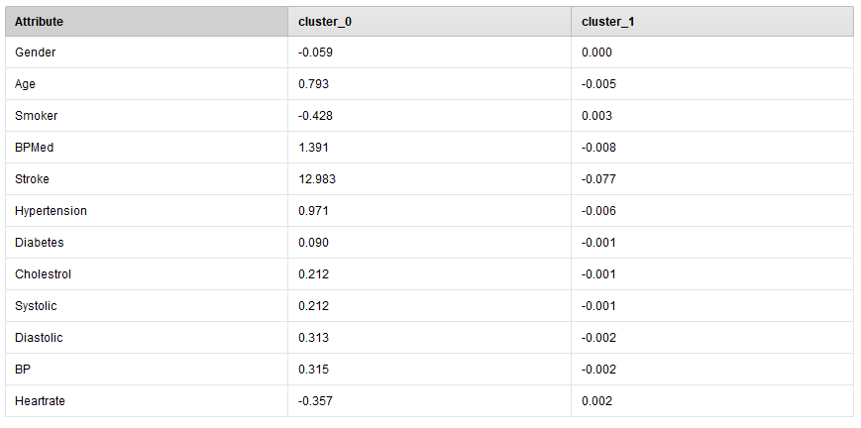
Cont…
Cluster Model
Cluster 0: 25
Cluster 1: 4215
Total number
of items: 4240

Slide 20
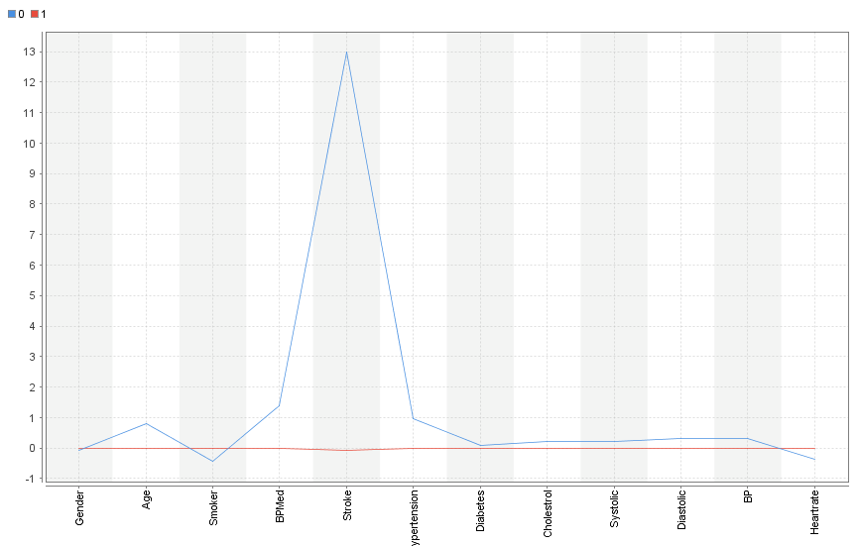
Plot

Slide 21
Learning Aspect & Conclusion
Data Preprocessing
Feature Extraction and Data Cleaning
Models
Naïve Bayes
KNN
K-Means
Tools
Jupyter
Weka
Rapidminer
Information and Confusion Matrix Understanding

Slide 22


